Slide 1

DIALYSIS OF PATIENTS

Slide 2
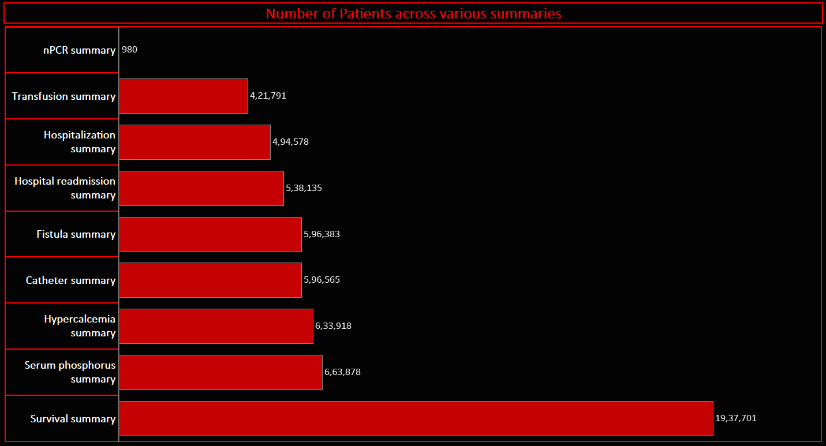
KPI – 1 Number of Patients across various summaries
Highest number of patients are in survival summary
Least number of patients are in nPCR summary

Slide 3
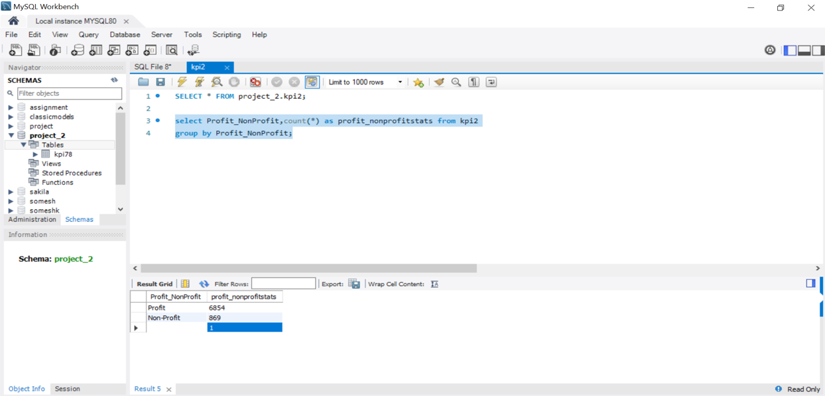
KPI – 2 Profit Vs Non-Profit Stats
Count of profit is 6854 which is 88.75%
Count of non profit is 869 which is 11.25%

Slide 4
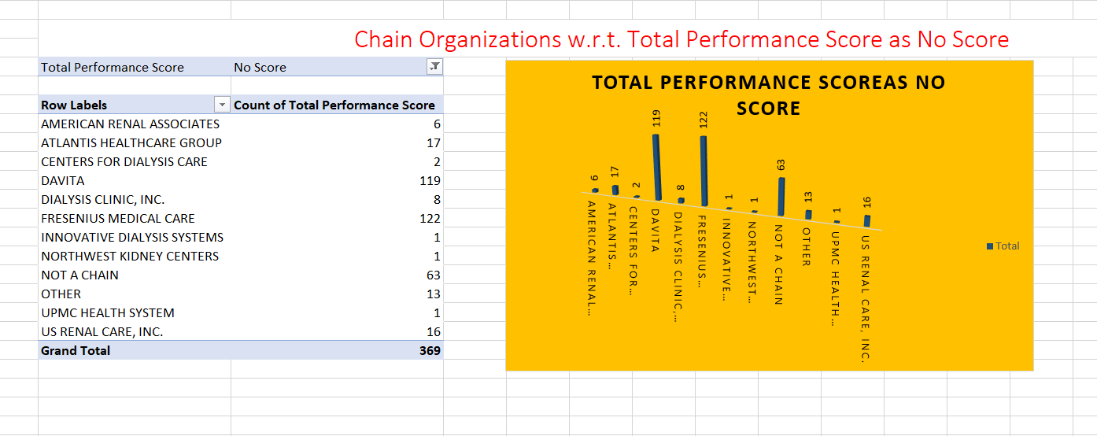
KPI – 3 Chain Organizations w.r.t. Total Performance Score as No Score
Most numbers of no score performance are in ‘ Fresenius medical care’ and ‘ Davita’ chain organization.
Total count of no score is 369.

Slide 5
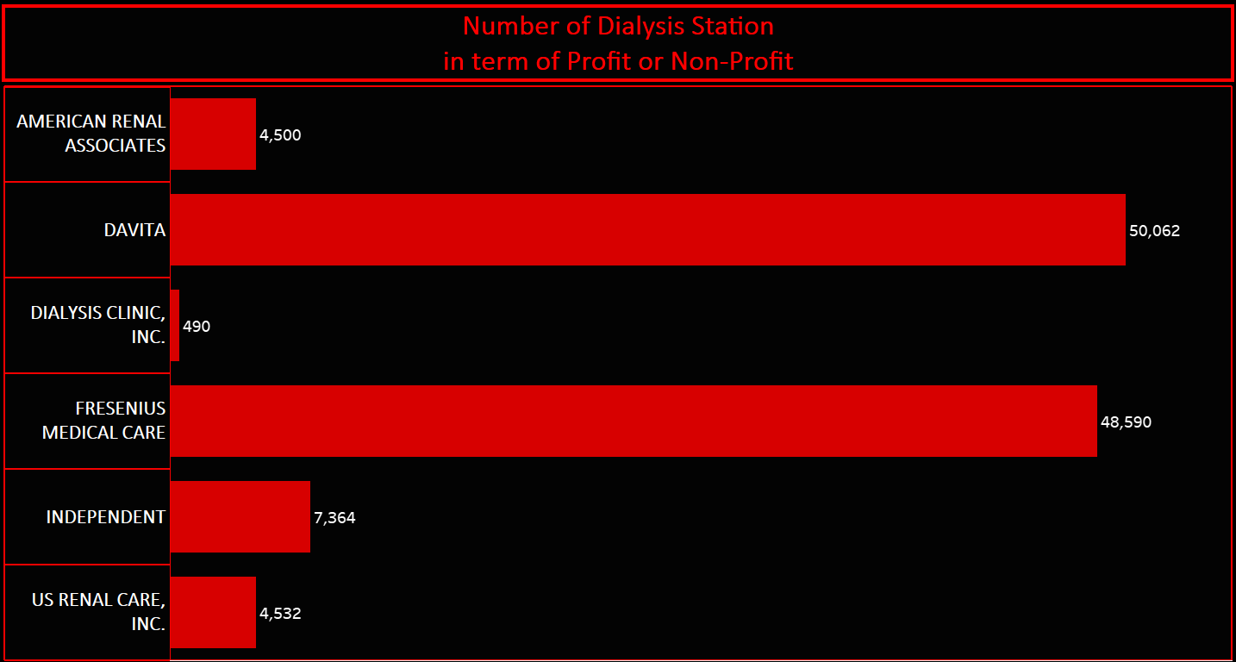
KPI – 4 Dialysis Stations Stats
Total number of dialysis station is 55328
Davita has highest number of dialysis station in terms of Profit
Independent has has highest number of dialysis station in terms of non profit

Slide 6
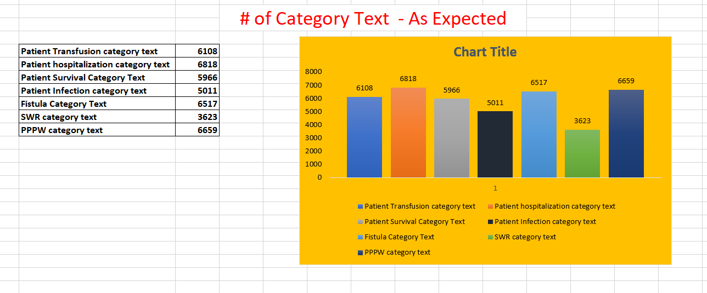
KPI – 5 No. of Category Text - As Expected

Slide 7
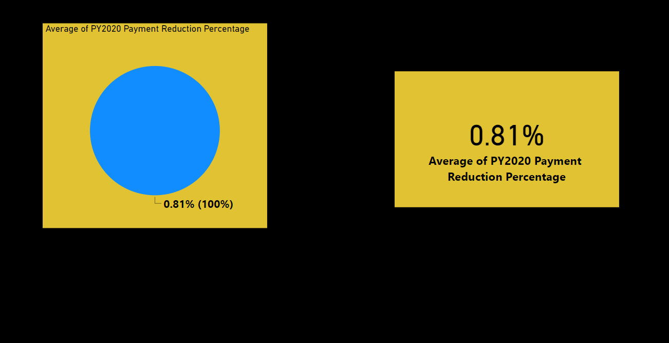
KPI – 6 Average Payment Reduction Rate
We had calculated the average payment reduction rate in percentage.

Slide 8
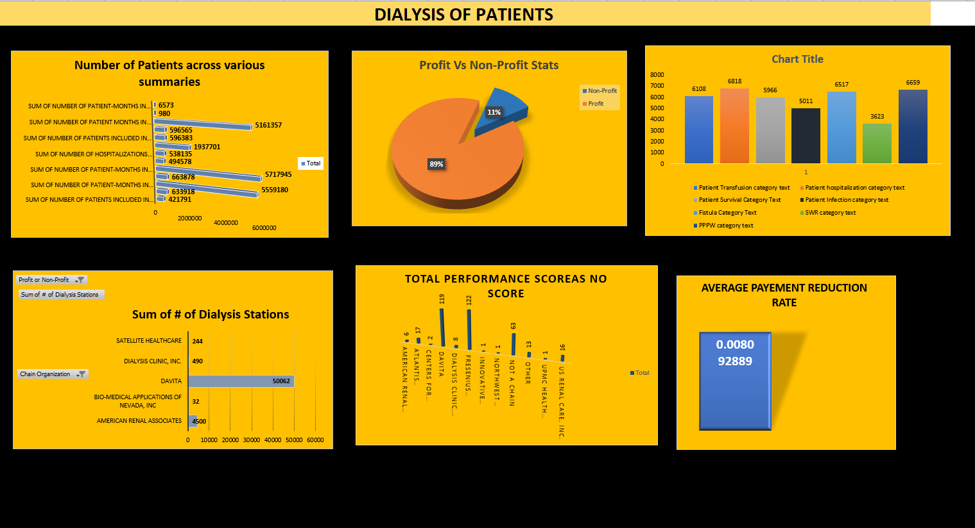
Excel module dashboard

Slide 9
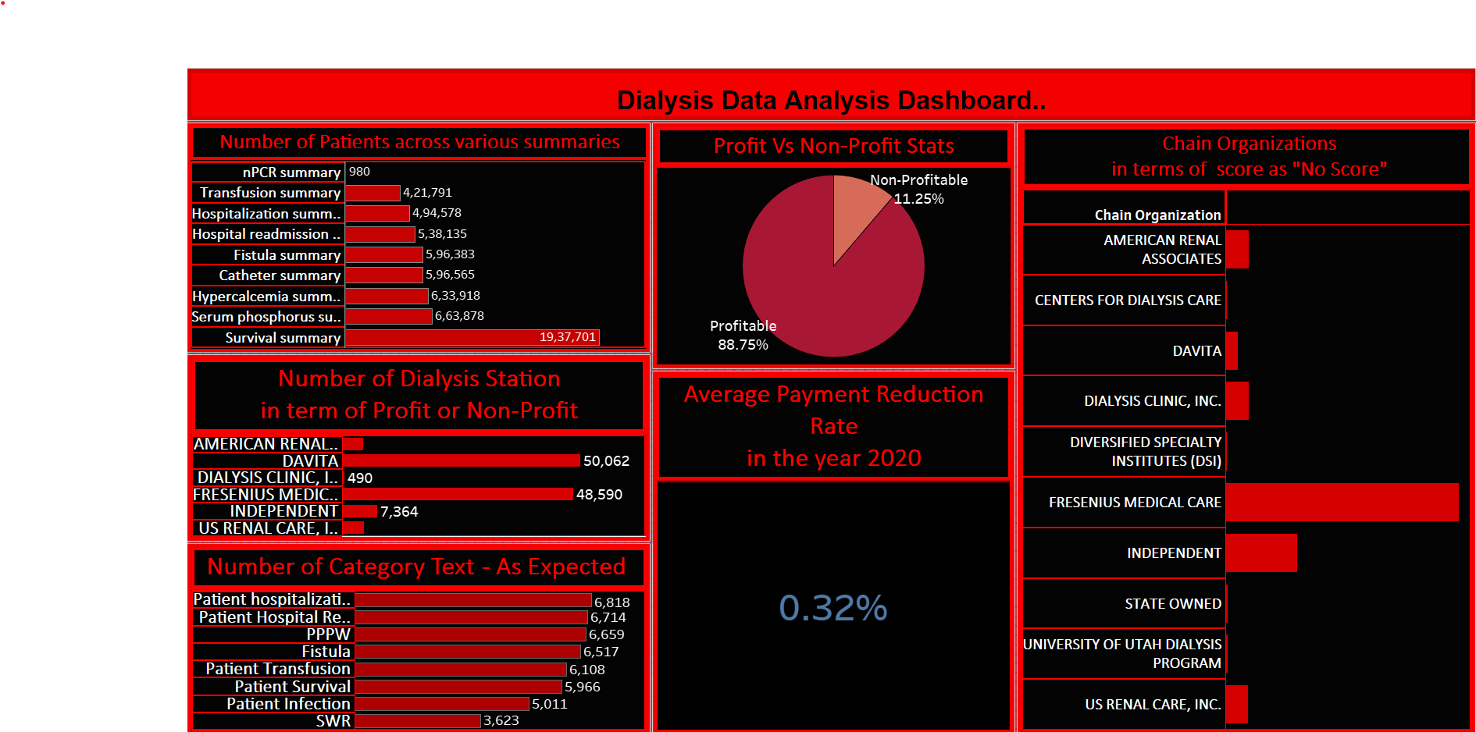
Tableau module dashboard

Slide 10
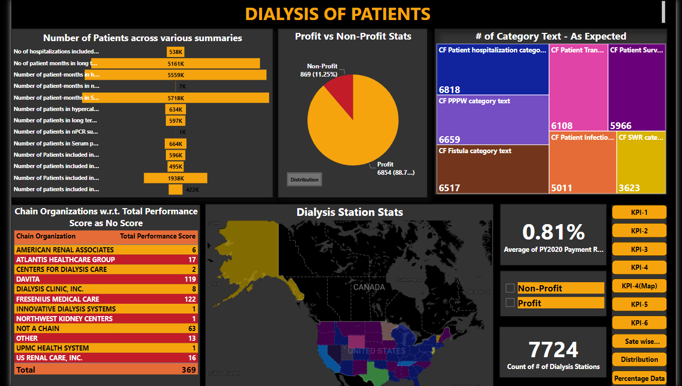
Power-bi module dashboard

Slide 11
Thank you

